Slide 1

Keep Climbing!
An advice by rabeb othmani, aka bibi

Slide 2
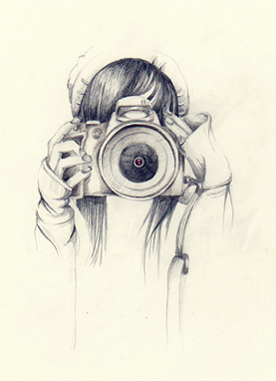






Slide 3
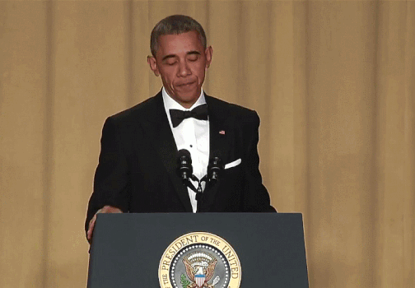
And so it begins!
Me:” Guess what? I’ve started climbing!”
Everyone who knows me: “But you’re scared of heights?!”
Me: "Exactly.”

Slide 4
fear
Acknowledge it
Find a way to deal with it
Don’t try to beat it, simply because you can’t (Well, maybe but not in round1)
Don’t let it interfere in your life decisions

Slide 5

Notes:
Dealing with fear in tech:
*imposter syndrome
*fear of failure
*trying to be invisible in the meeting room
*not contributing to that open source project on github
*not learning a new language
*not applying for that job

Slide 6

Notes:
Personal experience: getting my new job, a whole new experience for me. Challenging myself and my fears and getting out of my comfort zone
I still stress about public speaking but I keep doing it as well \OO/

Slide 7

The learning journey: mentorship

Slide 8
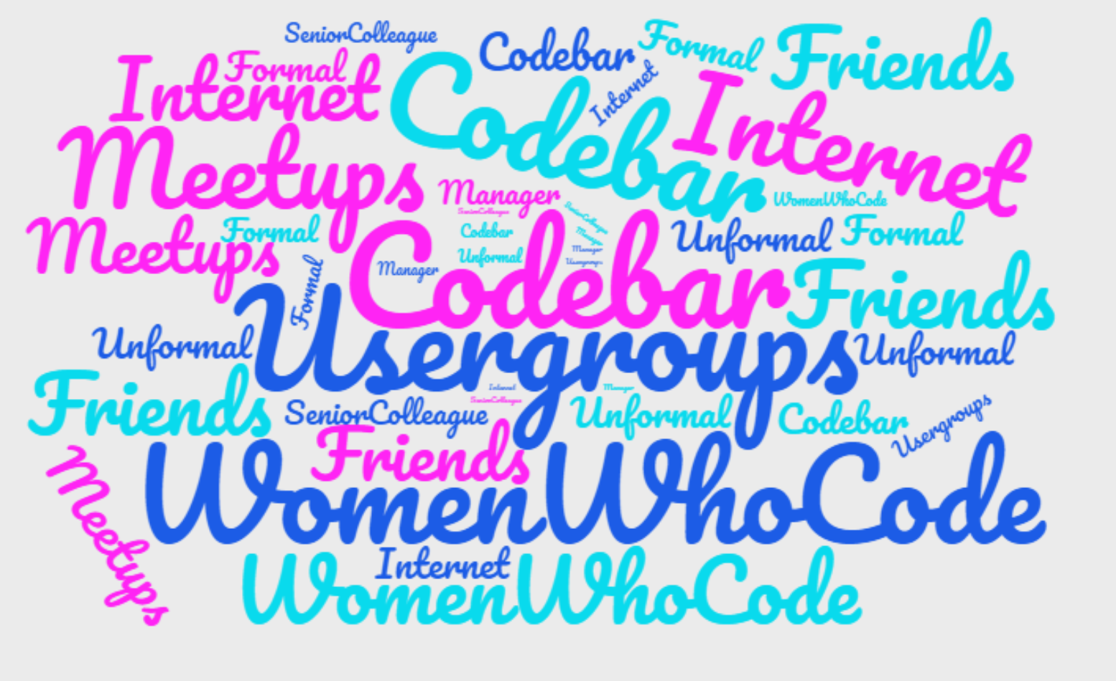
Notes:
Mentorship is not a vertical relationship, your peers could be your mentors too.
Build your own community, be part of a community where you can find support : technical and emotional support.
Ask for help, ask for mentorship and if you feel ready mentor some other people too. Use your knowledge to help others

Slide 9

The learning journey: be nice to yourself
Notes:
Don’t be harsh on yourself, take it easy, step by step
It is like a video game , once you finish a level, you can move to the next one

Slide 10
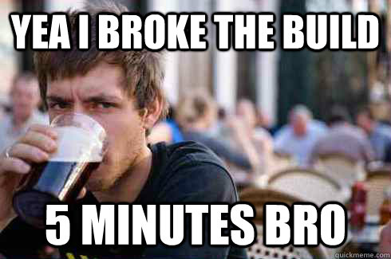
Notes:
We make mistakes, failure is part of the journey (as cheesy as it sounds but it’s true)
Your first website won’t look amazing or very performant, you need to iterate on work to get a better version.
You’ll break the build , not once not twice but few times

Slide 11

The learning journey: Commitment
Notes:
Be fierce, commit to the challenge :
Tell someone what are your plans so they can hold you accountable , blog about it and tweet about your progress with a hashtag maybe

Slide 12
Keep climbing
Challenge yourself
Be eager to learn
Remember that you are brave and capable
Have fun while climbing

Slide 13

Thank you!
@Rabeb_Othmani
Rabeb.othmani@vonage.com
http://rabebothmani.com

